Slide 1
Revolution of Processors

Slide 2
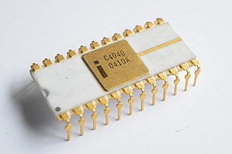
Intel 4040
1971/74?:
The 4040 employed a 10 μm silicon gate enhancement-load PMOS technology
3,000 transistors
Could execute approximately 62,000 instructions per second
60 instructions

Slide 3
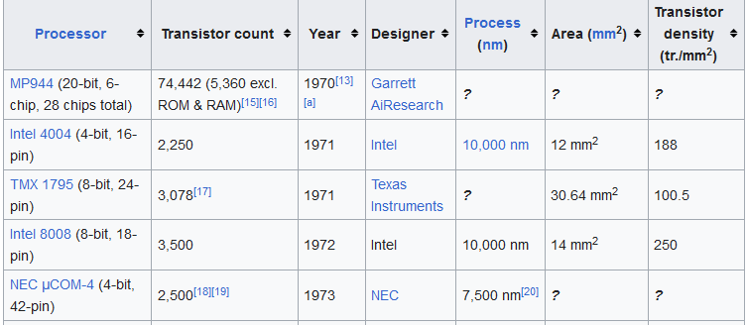
https://en.wikipedia.org/wiki/Transistor_count

Slide 4
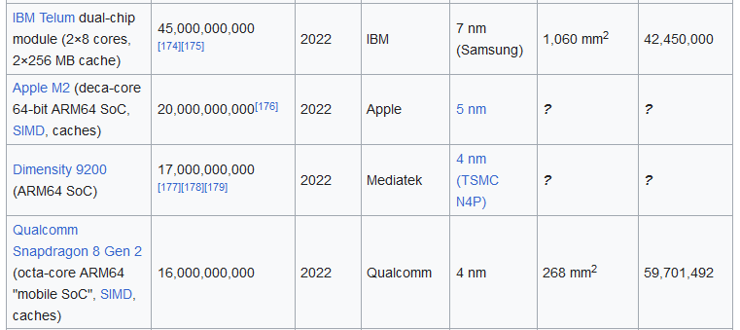
https://en.wikipedia.org/wiki/Transistor_count

Slide 5
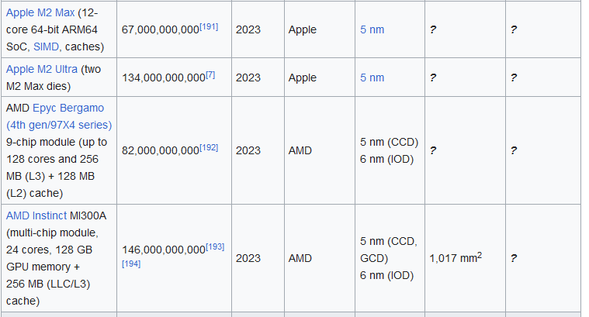
https://en.wikipedia.org/wiki/Transistor_count

Slide 6
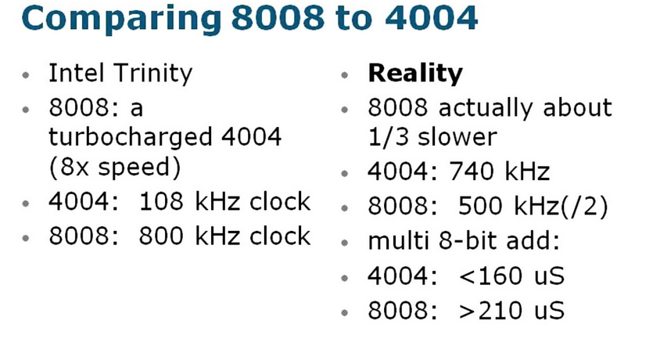
https://www.youtube.com/watch?app=desktop&v=H1Y60tQ59b4

Slide 7
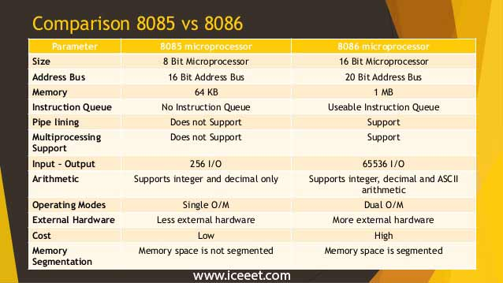

Slide 8
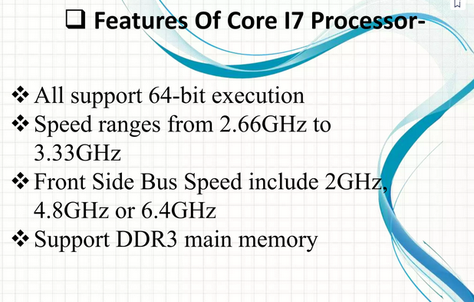
https://www.slideshare.net/Gautam2112/intel-core-i7-processor

Slide 9
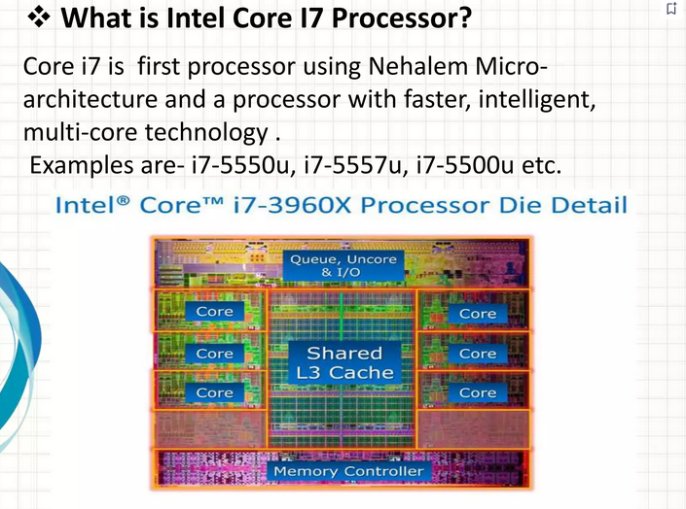

Slide 10
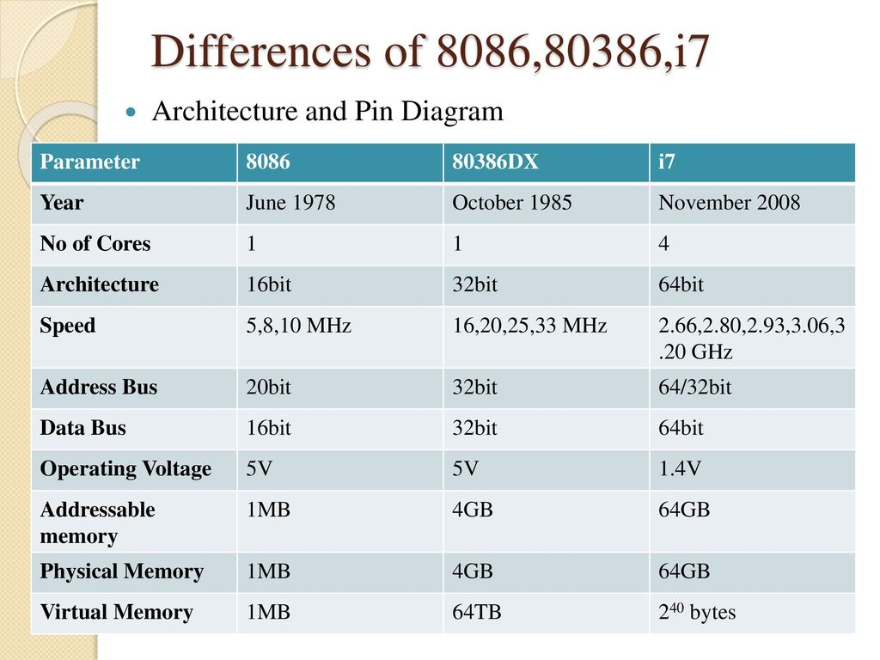

Slide 11
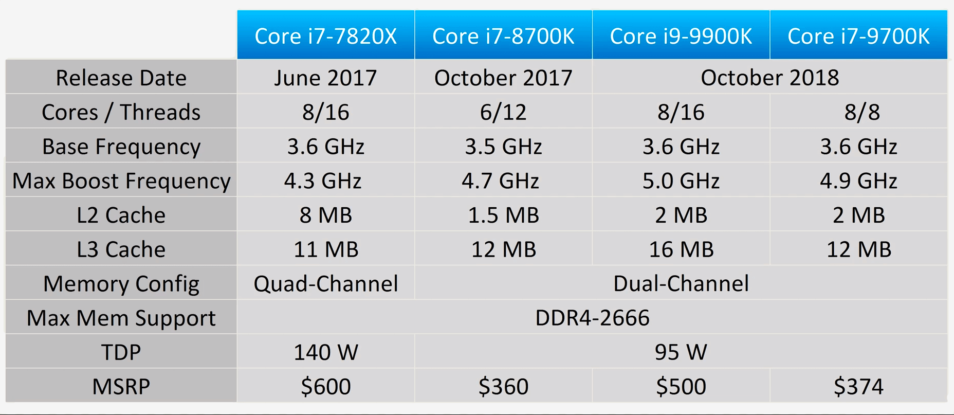

Slide 12
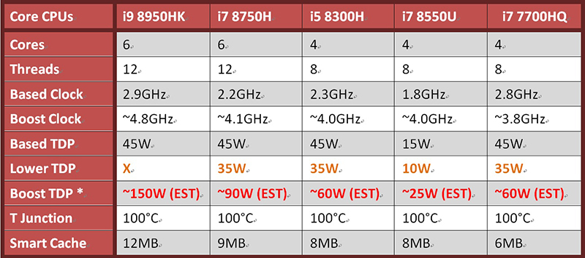
thermal design power (TDP)?

Slide 13
